Slide 1

DATATYPES IN PYTHON
Mrudula A P

Slide 2
Introduction
In Python programming, a data type is the classification of data that defines the possible operations that can be done on the object.
Data type determines the type of data stored into a variable or memory.
Data types are important in programming languages because they help the compiler or interpreter more efficiently allocate memory.
1) The datatypes which are already available in Python language are called Built-in datatypes.
2) The datatypes created by the programmers are called Used-Defined datatypes.

Slide 3
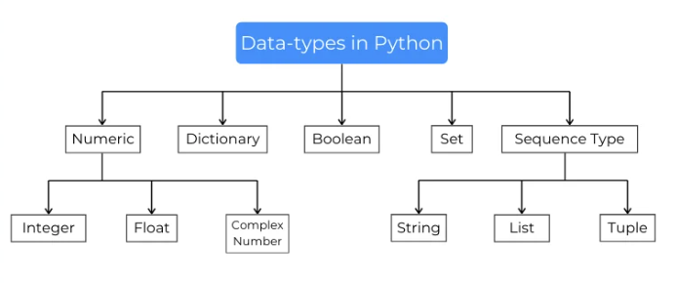
To show the data type of a variable or an object in Python, use the type() function.

Slide 4
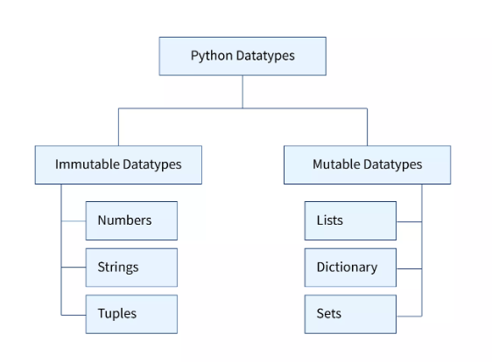
Mutable Vs Immutable Datatypes
Basically, mutable data types in Python are those whose value can be changed in place after they have been created.
In mutable data types, we can modify the already existing values of the data types or, we may add new values or remove the existing values from our datatypes.
The value assigned to a variable cannot be changed for the immutable data types.

Slide 5
Numeric Datatype
Numeric datatypes store numeric values.
They are immutable datatypes, means that changing the value of a numeric datatype results in a newly allocated object.
There are 3 numeric datatypes to present numbers:
Integer
Float
Complex

Slide 6
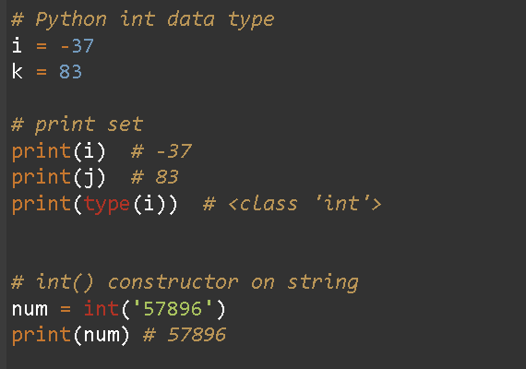
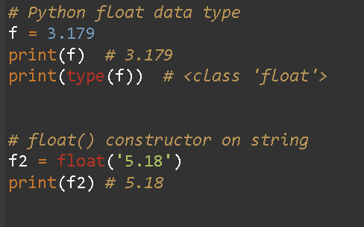
Integer
An integer is a whole number with no decimal places.
15 or -34 is an integer, but 45.0 is not
The name for integer datatype is int.
Ex : type(-25) is <class int>
Floating Point
A floating-point number or float is a number with decimal place.
23.0 is a float, but -34.5 is not
The name for floating-point datatype is float.
Ex: type(23.0) is <class float>

Slide 7
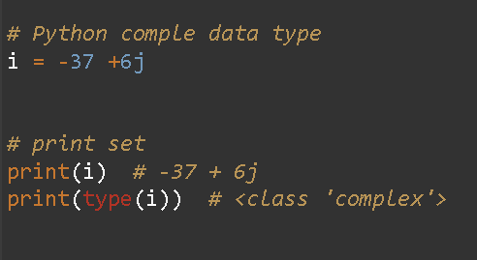
Complex Number
These datatypes stores the complex numbers in a variable.
Complex numbers are a combination of two different parts, one is a real part and another is the imaginary part.
Complex numbers are used to solve advance calculus problems.
Ex: C = 5+89j.

Slide 8
Dictionary
Python Dictionary is an unordered sequence of data stored as key-value pairs.
It is very useful to retrieve data in an optimized way among a large amount of data.
Creating a dictionary is done adding key, value pairs inside curly brackets ({}) or using the dict() constructor function.
Values in dictionaries can be selected passing the key string inside the square brackets ([]) of the dictionary object.
Keys in dictionaries are unique in nature.

Slide 9
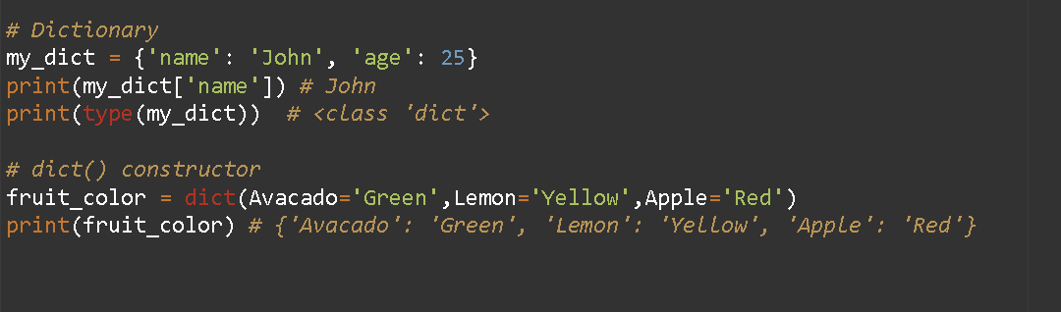

Slide 10
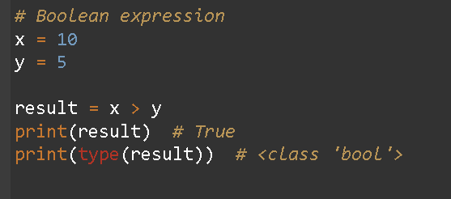
Boolean Datatype
Boolean data-type is used to store values with True and False.
Booleans are used to evaluate expressions and return TRUE or FALSE based on the result of the expression.

Slide 11
Sets
In Python, sets are an unordered collection unique elements (no duplicate values).
A Python set is a mutable object where you can add, remove, or modify elements after creating it.
Creating a set is done adding comma-separated values inside curly brackets ({}) or using the set() constructor function.
We cannot define the position of the element in the set but sets help find if the element is available in it or not.

Slide 12
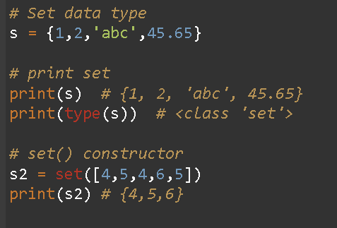
In Python Sets,
Duplicates are not allowed
They can have multiple data types
They can’t be accessed with the index

Slide 13
Frozenset Datatype
In Python, the frozenset data type represents an immutable set.
Creating a frozenset is done using the frozenset() constructor function. Once created, you cannot add, remove, or modify elements to the frozenset.
The difference between a set and a frozenset in Python is that the set is mutable and the frozenset is immutable.
You can change a set by adding, removing or modifying its elements, but doing so with a frozenset would result in an error.

Slide 14
Sequence
The sequence in a python programming language is a collection of data of same data-type or different data-type.
In sequences, we can store items or elements and can efficiently perform operations. The sequence elements are used in performing various operations.
The sequence is subdivided in three parts: List, String, Tuple

Slide 15
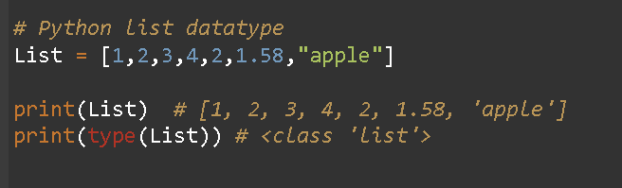
Lists
In Python, the list data type is used to store ordered sequence of elements.
Lists are used to store values of same and different data types like integer, string, float, etc.
List elements can be accessed, iterated, and removed.

Slide 16
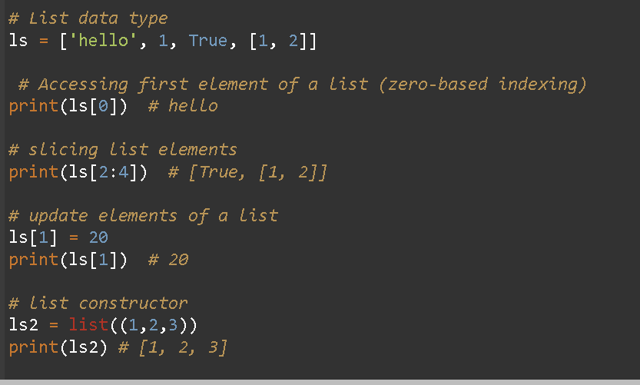
Creating a list is done using the square brackets ([]) or the list() constructor function

Slide 17
Tuple
Tuples are an ordered and immutable sequence that store a collection of data.
We can perform operations on tuple but we cannot remove or append elements in the tuple.
These data types allow duplicate values and values with multiple datatypes.
Creating a tuple is done using the parentheses (()) or the tuple() constructor function

Slide 18
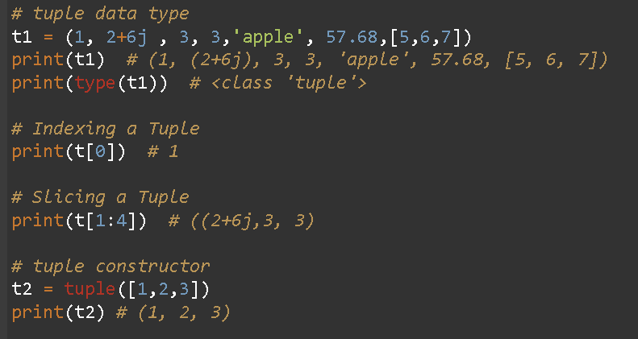

Slide 19
String
The str data type is used to define text component enclosing a sequence of characters within single-quotes or double-quotes.
Strings can contain letters, numbers or special characters. In Python, there is no datatype as a character, and a character is treated as the string of length 1.
It is immutable data-type but has the property of iterations. We can perform many different operations on strings.

Slide 20
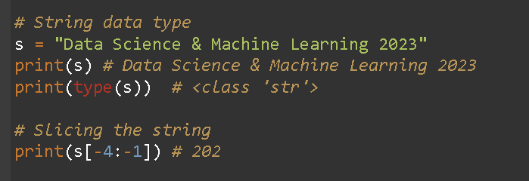

Slide 21
Thank You..

